Slide 1
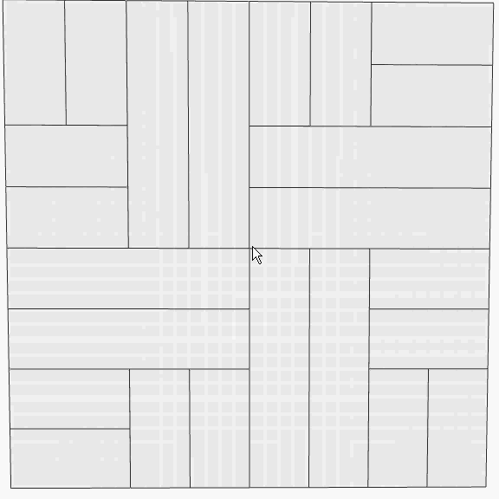
WaveFlow Execution Engine
Agents are relocatable
Just-in-Time Place and Route of Agents into CGRA
Runtime manages hook-ups to FIFOs and external resources.
Average “mount” time < 500usec
Avoids areas of CGRA with manufacturing defects to reduce cost.
Wave Confidential. Copyright 2017.

